Slide 1
Titanic EDA

Slide 2
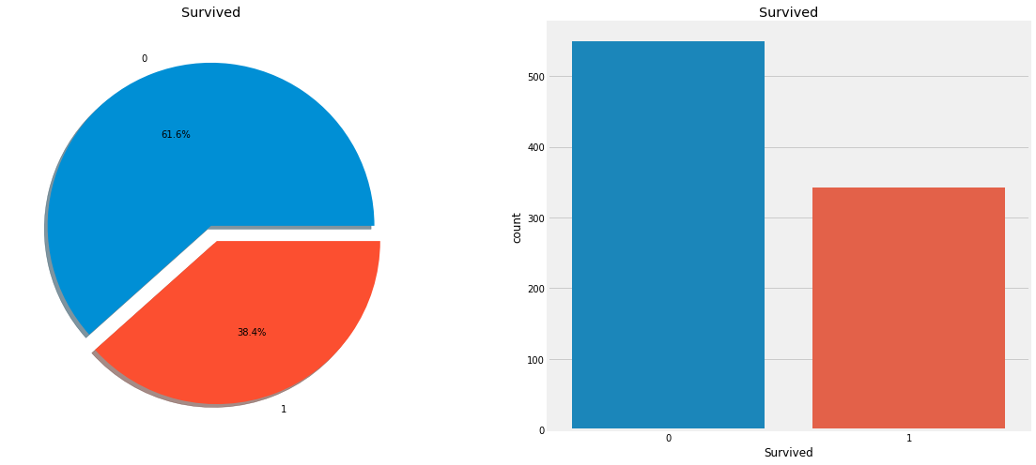
How many survived?

Slide 3
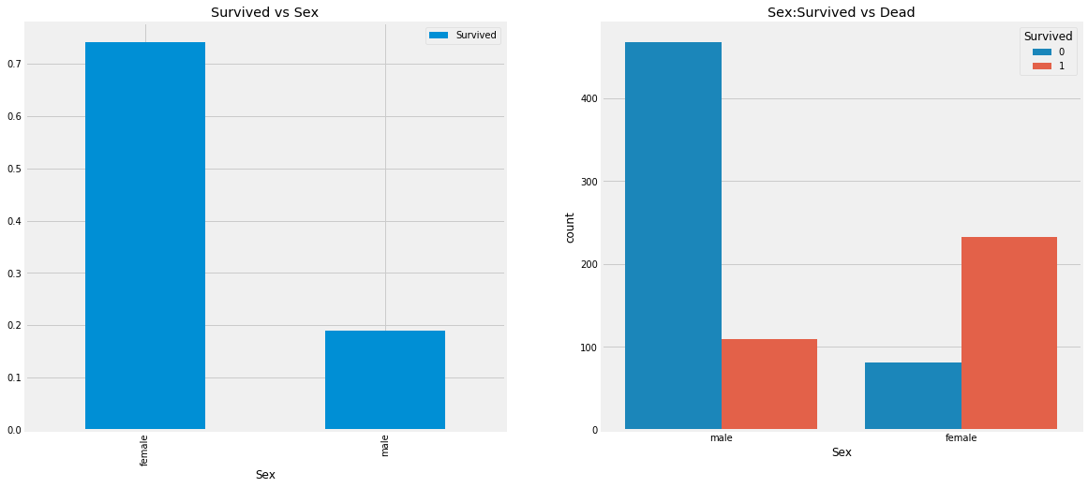
Sex-categorical feature

Slide 4
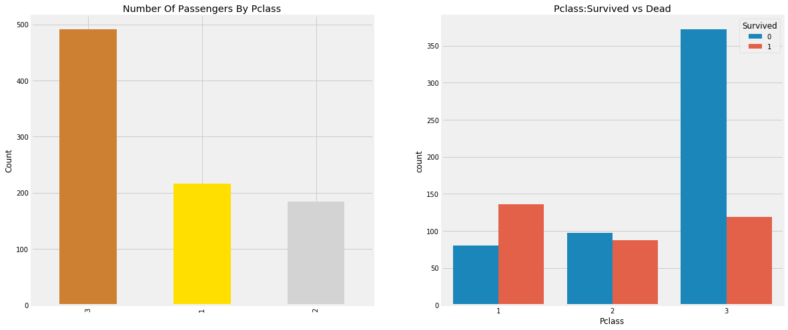
Pclass-ordinal feature

Slide 5
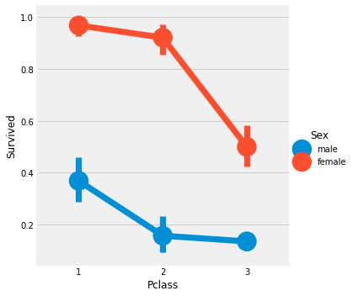

Slide 6
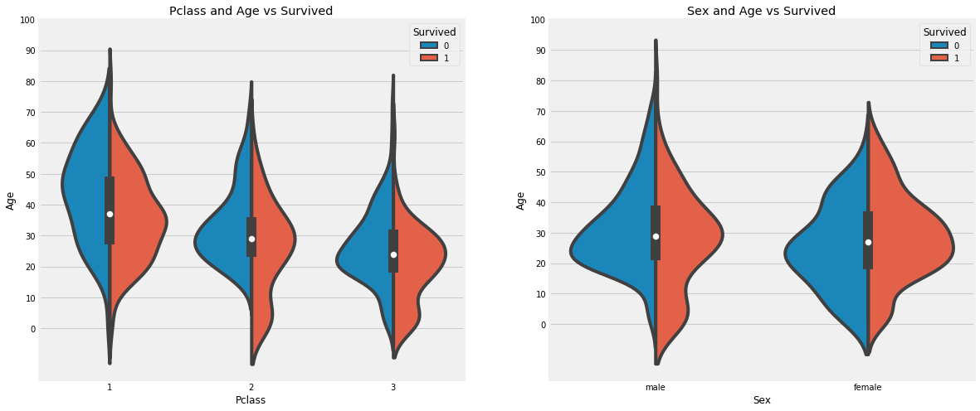
Age--> Continous Feature

Slide 7
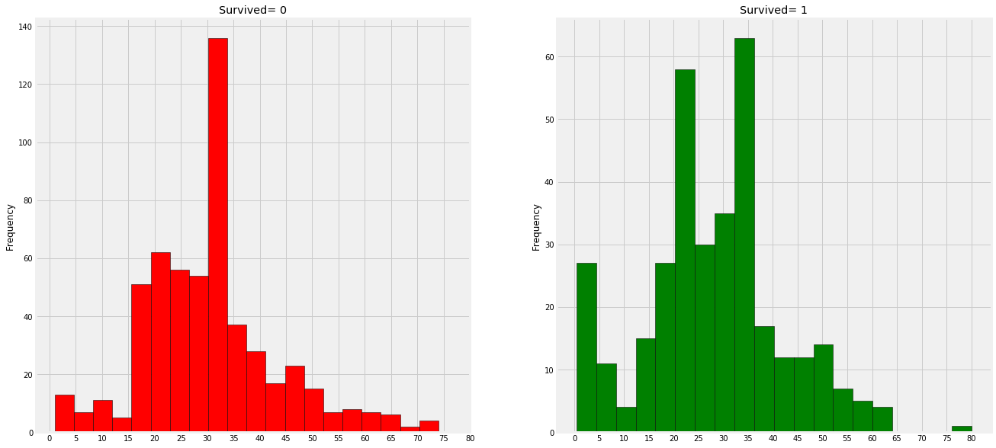
Filling NaN Ages

Slide 8
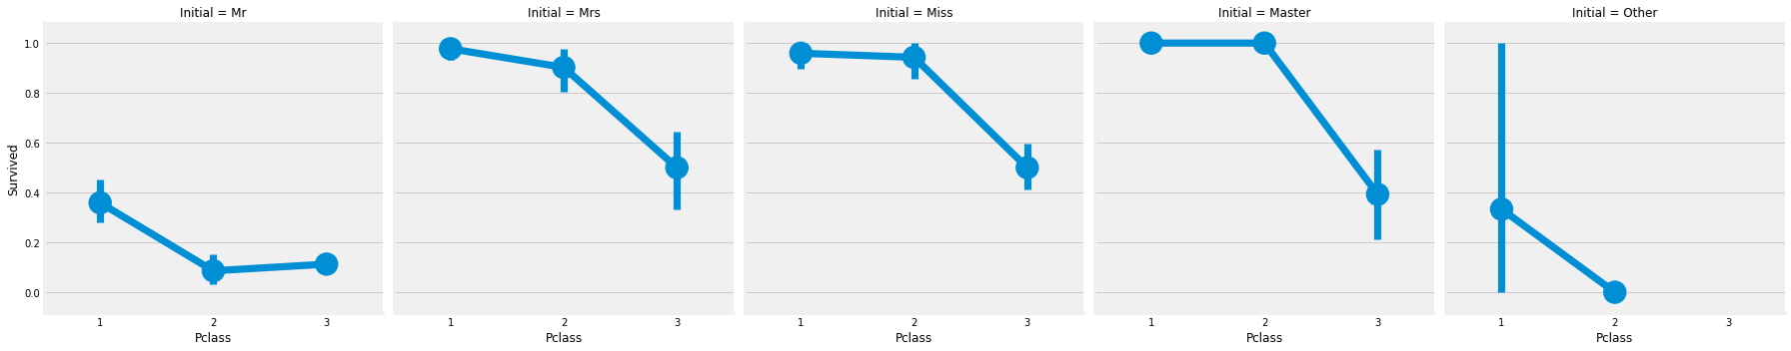

Slide 9
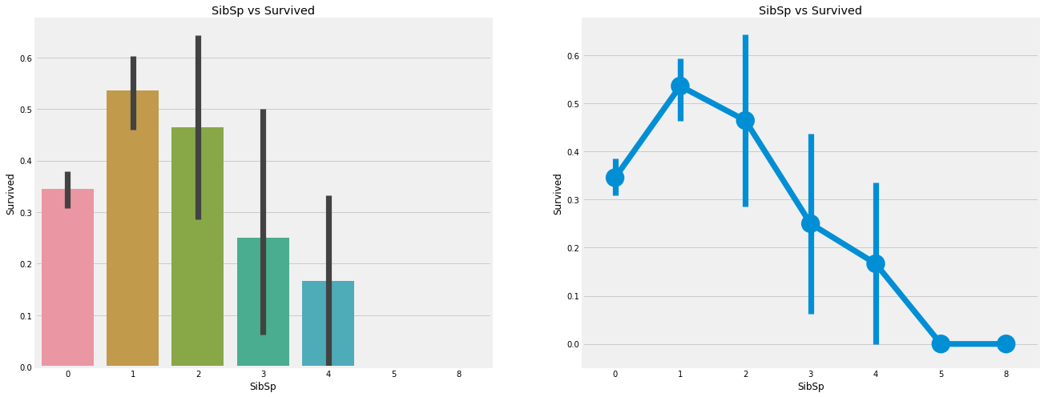
Embarked--> Categorical Value

Slide 10
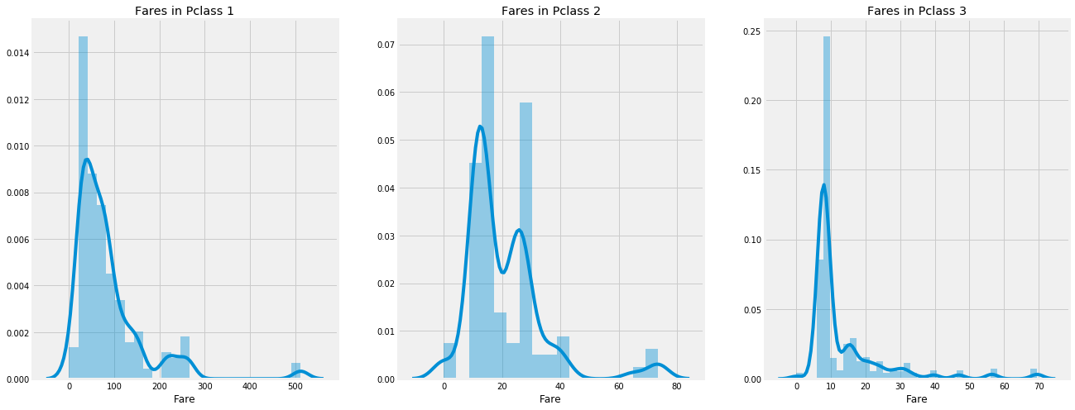
Fare--> Continous Feature

